Slide 1
Prototype model
By: Farah Jabeen

Slide 2
Prototype model
The basic idea in Prototype model is that instead of freezing the requirements before a design or coding can proceed, a throwaway prototype is built to understand the requirements.
This prototype is developed based on the currently known requirements. Prototype model is a software development model. By using this prototype, the client can get an “actual feel” of the system, since the interactions with prototype can enable the client to better understand the requirements of the desired system.

Slide 3
Prototype model
Prototyping is an attractive idea for complicated and large systems for which there is no manual process or existing system to help determining the requirements.
The prototype are usually not complete systems and many of the details are not built in the prototype. The goal is to provide a system with overall functionality.

Slide 4
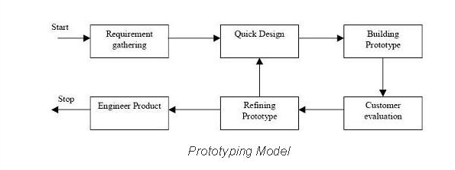
Diagram of Prototype model

Slide 5
When to use Prototype model
Prototype model should be used when the desired system needs to have a lot of interaction with the end users.
Typically, online systems, web interfaces have a very high amount of interaction with end users, are best suited for Prototype model. It might take a while for a system to be built that allows ease of use and needs minimal training for the end user.
Prototyping ensures that the end users constantly work with the system and provide a feedback which is incorporated in the prototype to result in a useable system. They are excellent for designing good human computer interface systems.

Slide 6
Advantages of Prototype model
Users are actively involved in the development
Since in this methodology a working model of the system is provided, the users get a better understanding of the system being developed.
Errors can be detected much earlier.
Quicker user feedback is available leading to better solutions.
Missing functionality can be identified easily
Confusing or difficult functions can be identified Requirements validation, Quick implementation of, incomplete, but functional, application.

Slide 7
Disadvantages of Prototype model
Leads to implementing and then repairing way of building systems.
Practically, this methodology may increase the complexity of the system as scope of the system may expand beyond original plans.
Incomplete application may cause application not to be used as the full system was designed Incomplete or inadequate problem analysis.

Slide 8
Agile model

Slide 9
Agile model
Agile development model is also a type of Incremental model. Software is developed in incremental, rapid cycles. This results in small incremental releases with each release building on previous functionality.
Each release is thoroughly tested to ensure software quality is maintained. It is used for time critical applications.

Slide 10
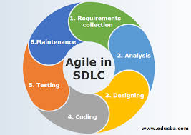
Diagram of Agile model

Slide 11
When to use Agile model
When new changes are needed to be implemented. The freedom agile gives to change is very important. New changes can be implemented at very little cost because of the frequency of new increments that are produced.
To implement a new feature the developers need to lose only the work of a few days, or even only hours, to roll back and implement it.

Slide 12
When to use Agile model
Unlike the waterfall model in agile model very limited planning is required to get started with the project. Agile assumes that the end users’ needs are ever changing in a dynamic business and IT world.
Changes can be discussed and features can be newly effected or removed based on feedback. This effectively gives the customer the finished system they want or need.

Slide 13
Advantages of Agile model
Customer satisfaction by rapid, continuous delivery of useful software.
People and interactions are emphasized rather than process and tools. Customers, developers and testers constantly interact with each other.
Working software is delivered frequently (weeks rather than months).
Face-to-face conversation is the best form of communication.

Slide 14
Advantages of Agile model
Close, daily cooperation between business people and developers.
Continuous attention to technical excellence and good design.
Regular adaptation to changing circumstances.
Even late changes in requirements are welcomed

Slide 15
Disadvantages of Agile model
In case of some software deliverables, especially the large ones, it is difficult to assess the effort required at the beginning of the software development life cycle.
There is lack of emphasis on necessary designing and documentation.

Slide 16
Disadvantages of Agile model
The project can easily get taken off track if the customer representative is not clear what final outcome that they want.
Only senior programmers are capable of taking the kind of decisions required during the development process. Hence it has no place for newbie programmers, unless combined with experienced resources.

